Slide 1
VR Program Management: Quality Assurance
Rehabilitation Research and Technical Assistance Center on VR Program Management (RTAC)
Institute for Community Inclusion
Susan Foley, PhD
Julisa Cully, MEd

Slide 2
RTAC Partners
Institute for Community Inclusion, University of Massachusetts Boston
InfoUse, Berkeley, California
Industrial & Labor Relations (ILR) School, Cornell University, Ithaca, NY

Slide 3
Goal
Improve the performance of the state VR agencies through the development, testing, and dissemination of effective and efficient management practices integrated into a model tailored to the state-federal VR program.
Build a research base to support advancement of the VR program.

Slide 4
Management Practices
Key areas of management practices:
  Strategic Planning
  Quality Assurance
  Human Resources
Focus on management practices: how to use information from QA, SP, and HR to pilot the organization

Slide 5
Management Model
Consider efficiency
Focus upon outcomes
Incorporate design that allows substantial adaption
RTAC will engage State VR Directors to identify challenges, strengths and utilizing management model

Slide 6
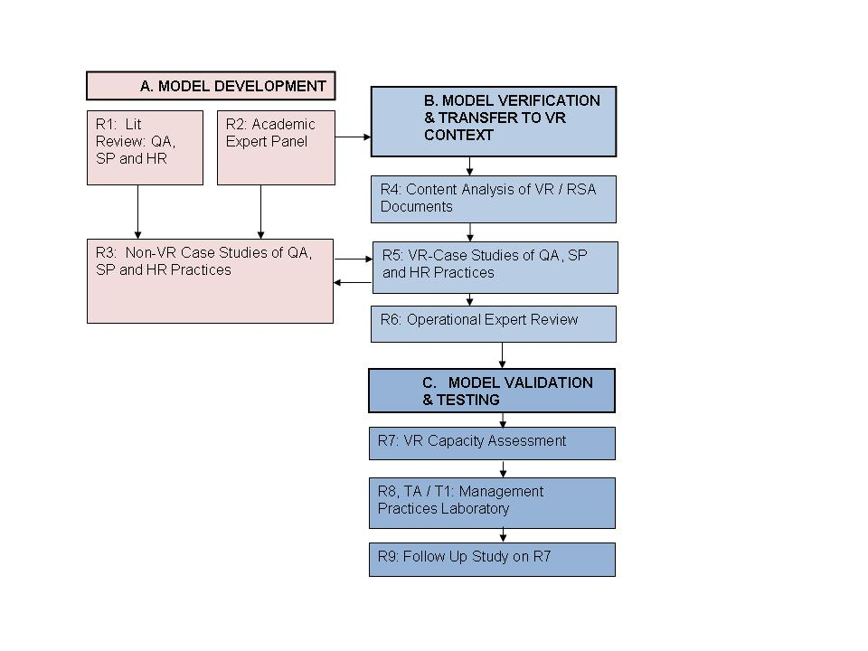
RTAC Overview

Slide 7
Model Development Phase
Purpose: Gather available information and evidence on management practices likely to improve VR outcomes
  Extensive literature review
  Academy and VR expert opinion
  Case studies of non VR practices
Notes:
Identify practices of connection to organizational outcomes
On-site case studies to observe QA practices in non-VR settings and assess evidence for
outcomes and indicators
data collection techniques
associated costs
implementation issues
Institute for Community Inclusion, UMass Boston

Slide 8
Model Verification and
Transfer to VR System
Purpose: Verify and transfer available information to the VR system
  Content analysis of RSA/VR documents
  Case studies of VR practices in QA, HR, and SP
  VR Expert Opinion

Slide 9
Model Validation and Testing
Purpose: Live testing of model developed in previous stages
  Baseline measures and preliminary investigation of status of pilot agencies (R7)
  Pilot implementation of model and adaptation to local context (R8)
  Outcome measures and post-testing of VR program management model implementation (R9)
Notes:
Case studies of VR practices in situ
Institute for Community Inclusion, UMass Boston

Slide 10
Quality Assurance – Management Perspective
How can QA reports influence management decision-making?
How can QA information guide policy making?
How does QA information influence resource allocation?
How does QA information influence human resource investment?

Slide 11
Working with VR program evaluation and QA specialists
Collaboration with TACE and QA Community of Practice
Anticipate long range engagement with InfoUse being lead on QA

Slide 12
Providing TA
TACE
QA Community of Practice
RTAC

